Slide 1
Time and Space Complexity

Slide 2
AGENDA
• Time and Space Complexity
• Time and Space Complexity Exercises
• More Whiteboarding Problems

Slide 3
Time and Space Complexity

Slide 4
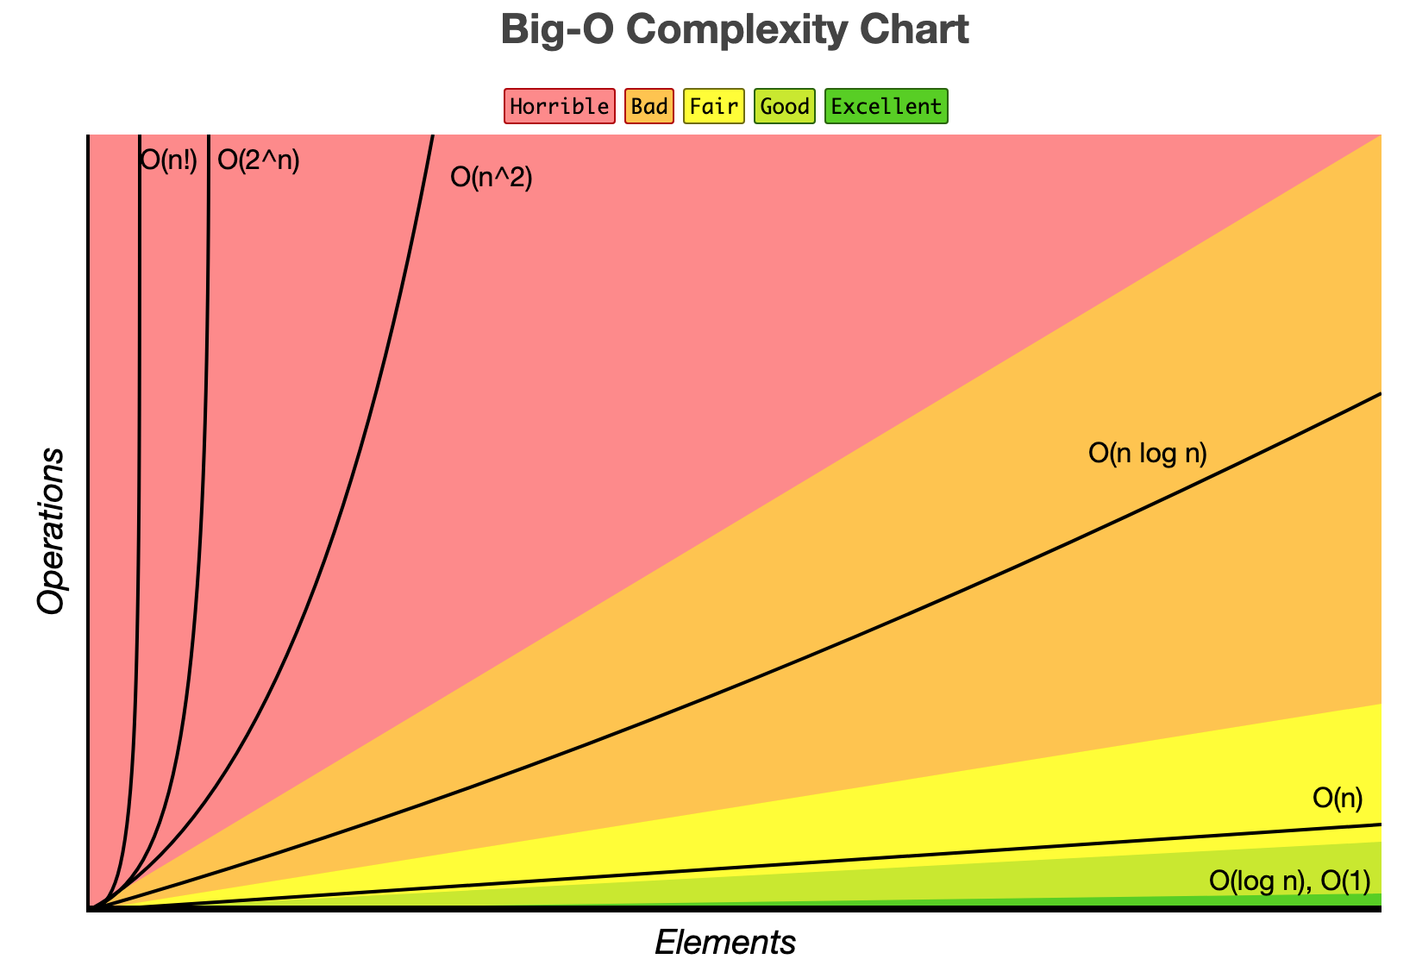
TIME AND SPACE COMPLEXITY
• How can we measure the performance of our algorithm?
• Measure it with respect to the size of our input
• We take into account how runtime and space grows with respect to our input size
• We represent complexity using Big-O notation (e.g. O(n))
• These questions always gets asked in interviews!

Slide 5
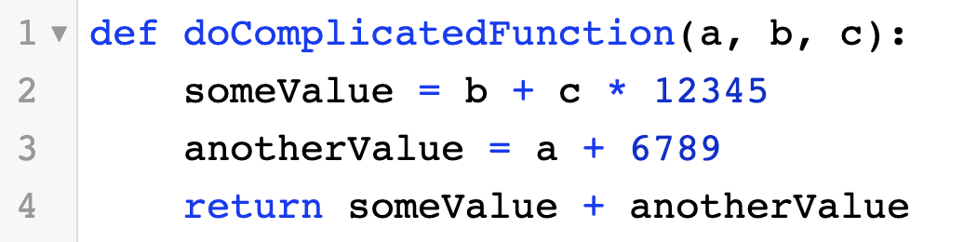
CONSTANT TIME/SPACE COMPLEXITY
• The runtime/space of our function doesn’t change with respect to our input. It stays constant.
• Written as O(1)
O(1) runtime & space

Slide 6
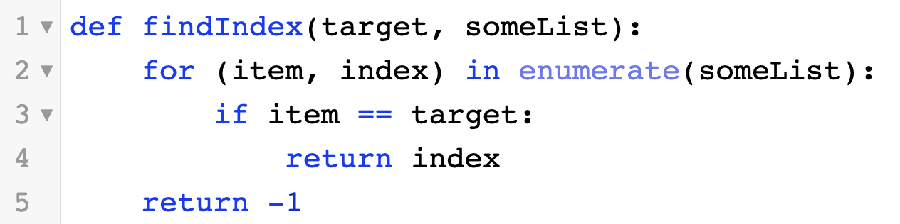
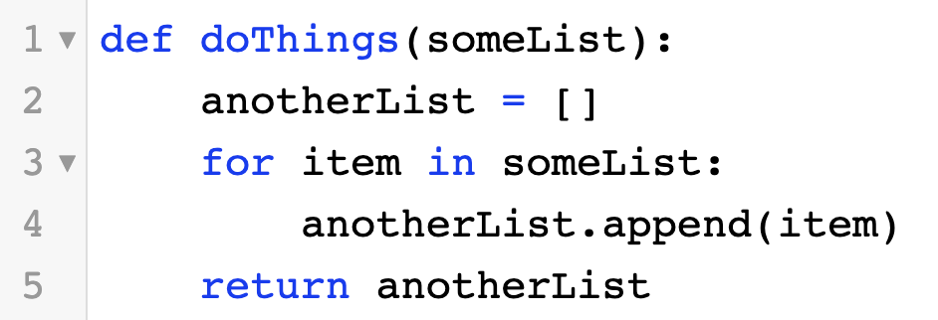
LINEAR TIME/SPACE COMPLEXITY
O(n) runtime, O(1) space
• The runtime/space of our function increases linearly as our input size grows
• Written as O(n)
O(n) runtime & space

Slide 7
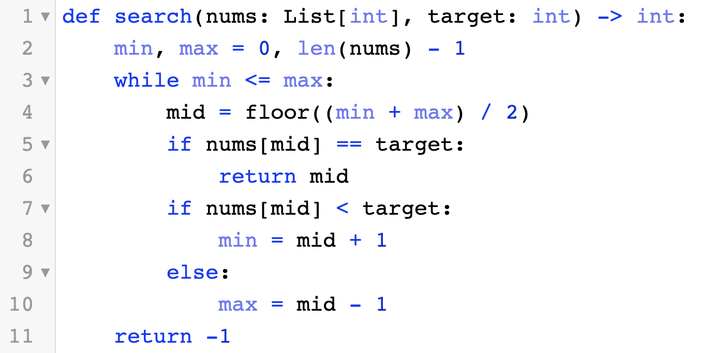
LOGARITHMIC TIME/SPACE COMPLEXITY
• The runtime/space of our function grows logarithmically with respect to the input size
• Written as O(logn)
• The algorithm on the right is called binary search, we’ll talk about this in a future lecture
O(logn) runtime, O(1) space

Slide 8
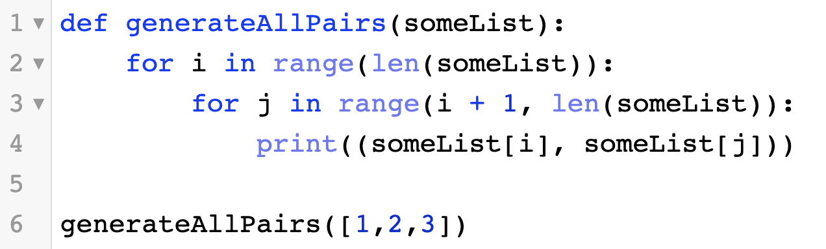
QUADRATIC TIME/SPACE COMPLEXITY
• The runtime/space of our function increases quadratically as our input size grows
• Written as O(n^{c}) where c is a constant
• A nested loop is usually a sign that something is in quadratic time
O(n²) runtime, O(1) space

Slide 9
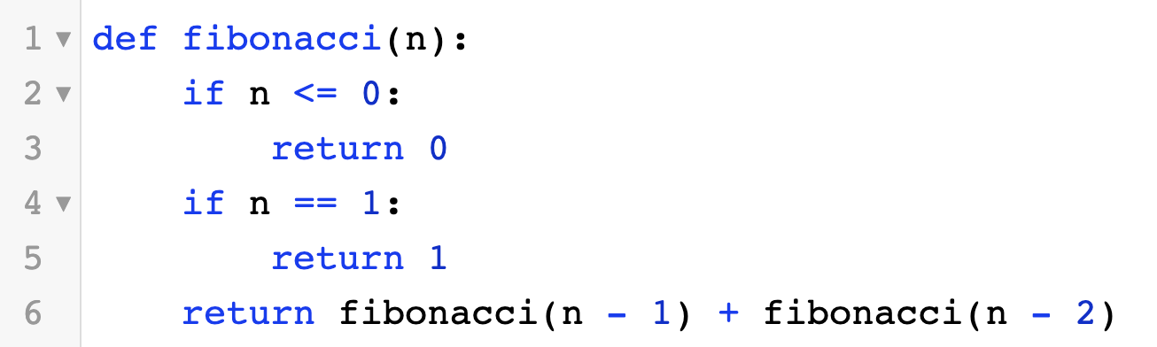
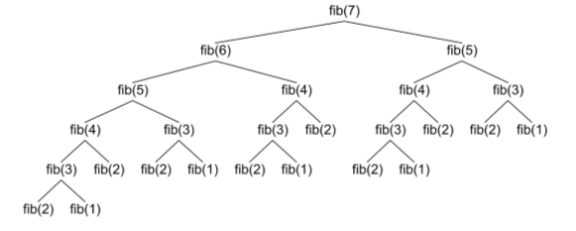
EXPONENTIAL TIME/SPACE COMPLEXITY
• The runtime/space of our function increases exponentially as our input size grows
• Written as O(c^{n}) where c is a constant
O(2^{n}) runtime, O(n) space

Slide 10
THINGS TO KNOW: TIME AND SPACE COMPLEXITY
• We only care about the dominant term (the variable that grows the fastest) and remove the constant multipliers
• O(2n² + 3n) = O(n²)
• Be sure to specify what the variables are
• O(n²) where n is the length of the list
• Make sure to memorize the chart on the right
• Really good reference for time/space complexity

Slide 11
Time/Space Complexity Exercises

Slide 12
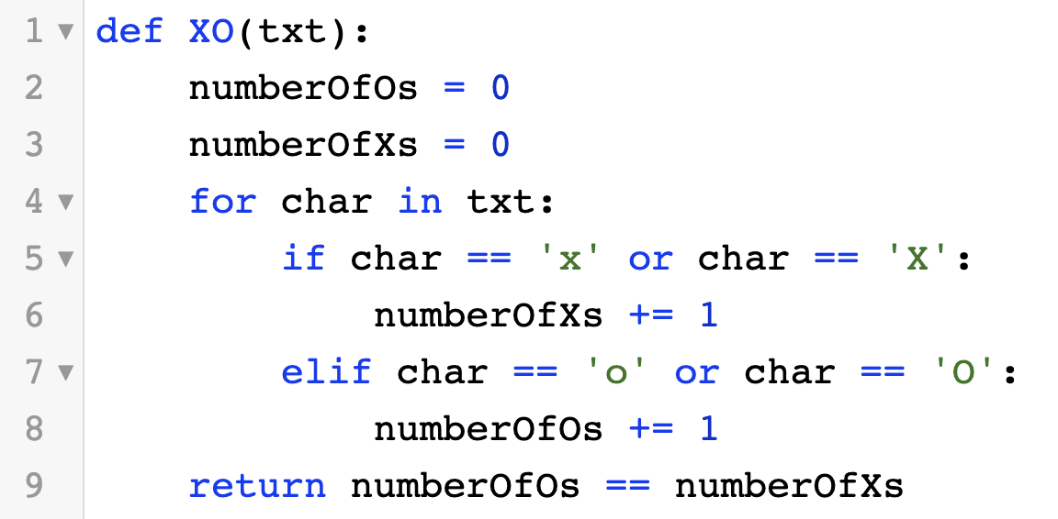
XO
• What’s the time/space complexity for this solution?

Slide 13
XO
• What’s the time/space complexity for this solution?
• Runtime: O(n) where n = length of txt
• Space: O(1)

Slide 14
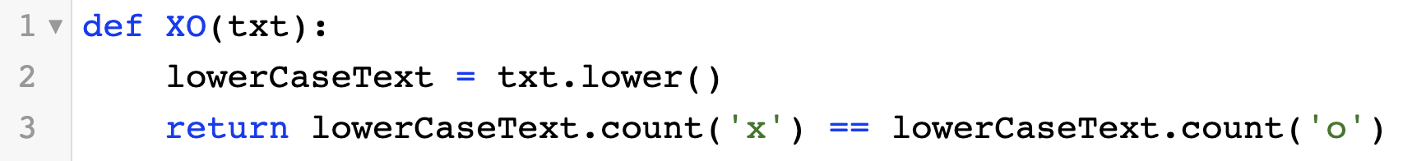
XO
• What’s the time/space complexity for this solution?

Slide 15
XO
• What’s the time/space complexity for this solution?
• Runtime: O(n) where n = length of txt
• Space: O(n) where n = length of txt

Slide 16
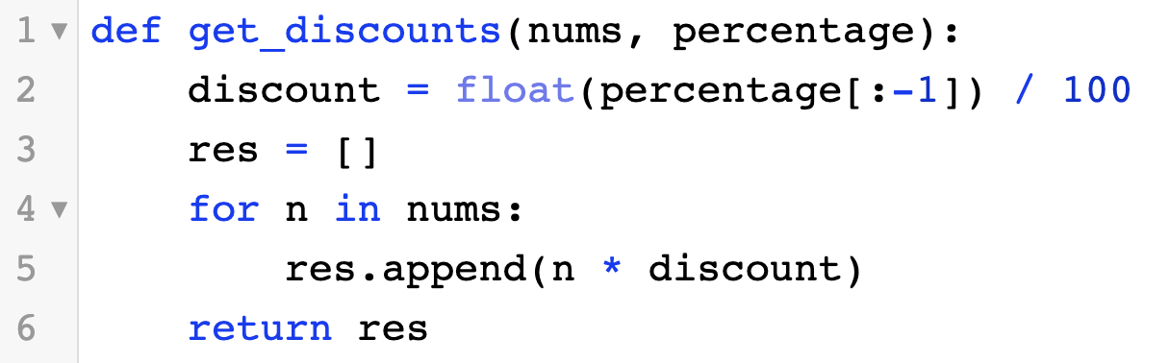
GET DISCOUNTS
• What’s the time/space complexity for this solution?

Slide 17
GET DISCOUNTS
• What’s the time/space complexity for this solution?
• Runtime: O(n) where n = length of nums
• Space: O(n) where n = length of nums

Slide 18
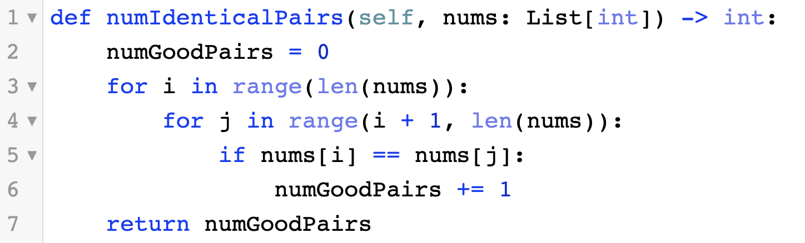
NUMBER OF GOOD PAIRS
• What’s the time/space complexity for this solution?

Slide 19
NUMBER OF GOOD PAIRS
• What’s the time/space complexity for this solution?
• Runtime: O(n) where n = length of nums
• Space: O(1)

Slide 20
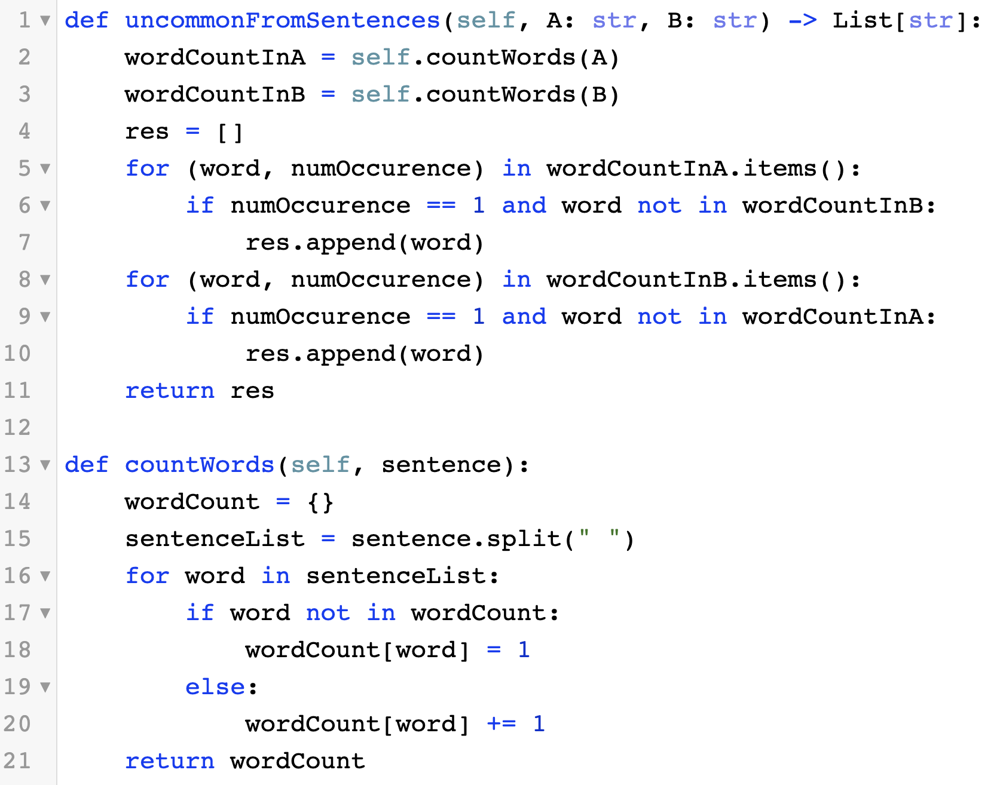
UNCOMMON WORDS
• What’s the time/space complexity for this solution?
• Hint: Inserting and lookup for Dictionaries are O(1) time

Slide 21
UNCOMMON WORDS
• What’s the time/space complexity for this solution?
• Runtime: O(m + n) where m = number of words in A, n = number of words in B
• Space: O(m + n) where m = number of words in A, n = number of words in B

Slide 22
Whiteboarding Problems

Slide 23
SINGLE NUMBER
• Find the number that appears only once
• Leetcode Link

Slide 24
TWO SUM
• Find if two pairs of numbers equal a certain sum
• Leetcode Link

